Slide 1


Slide 2


MAJOR PROJECT FAKE NEWS DETECTION
BY AAYUSH UJJWAL
(2201062040)

Slide 3
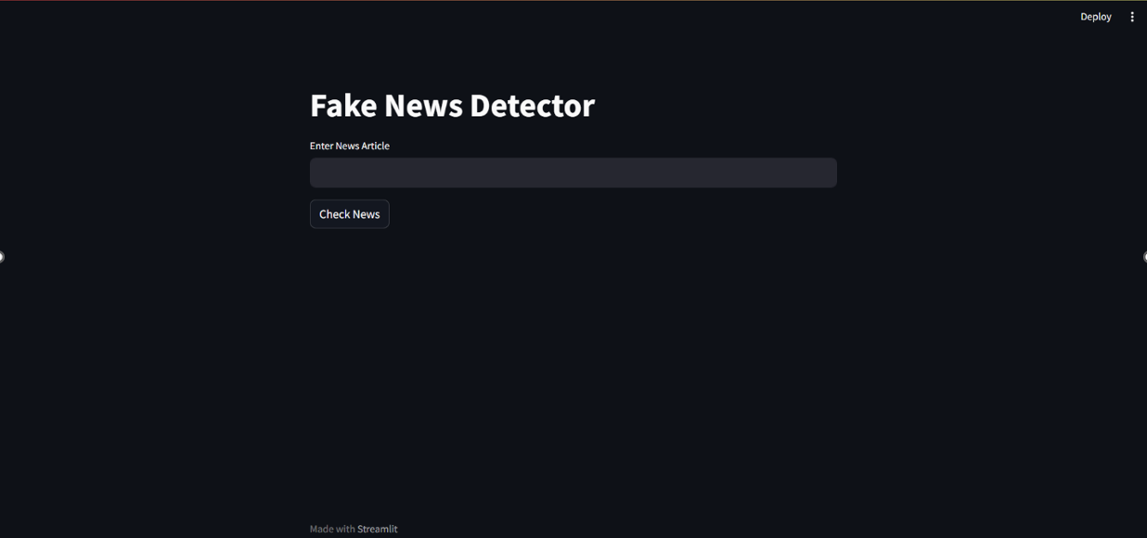

Slide 4

Introduction
These days, news about current events and particular areas of interest is broadcast on radio and television as well as written in newspapers and on social media worldwide.
Given the rapid expansion of online material, it is getting harder to distinguish between genuine and fake information.
Fake news has consequently spread like wildfire, making it extremely difficult for makers of such information to verify it to prevent public misinformation.
For getting better result we will implement an automated fake news classification model which classify the data into “Fake” or “Real”.

Slide 5
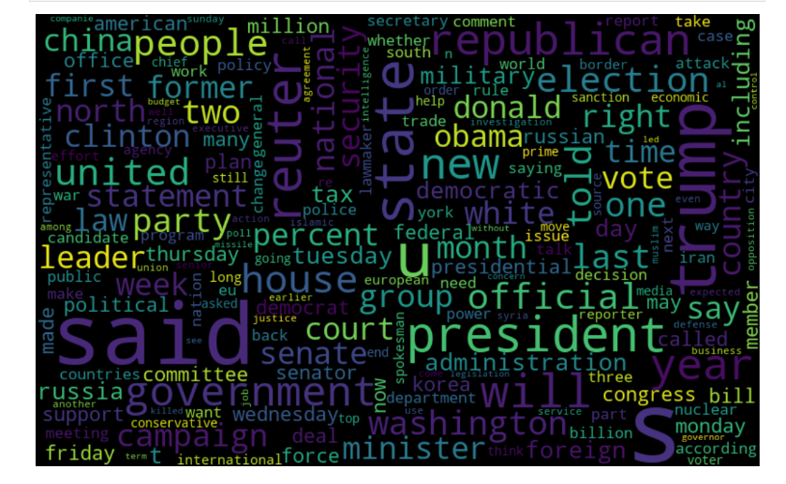
Objectives
This project helps to find a way to utilize Natural Language Processing (NLP) to identify and classify the fake news articles. The main objective is to detect the fake news, which is a classic text classification problem.
This advanced python project of detecting fake news deals with fake and real news. Using SK-Learn tools, we will use a Tf-idf Vectorizer on our dataset.
To know how well our model fares, we will use various models, which will result in an accuracy score and a performance metrices.
Our goal is to develop a model that can classifies between “Real” news and “Fake” news.

Slide 6
Problem Statement
In this day and age, it is extremely difficult to decide whether the news we come across is real or not. There are very few options to check the authenticity and all of them are sophisticated and not accessible to the average person. There is an acute need for a web-based fact-checking platform that harnesses the power of Machine Learning to provide us with that opportunity.
In this project we will work through NLP. We will remove the stop words, use tf-idf vectorization, drop unnecessary columns, visualize our data and fit models like logistic regression, random forest, gradient boosting, decision tree and at last will create a web interface through which user can check the news article by giving them as an input and get their output as “ fake news or true news”.

Slide 7
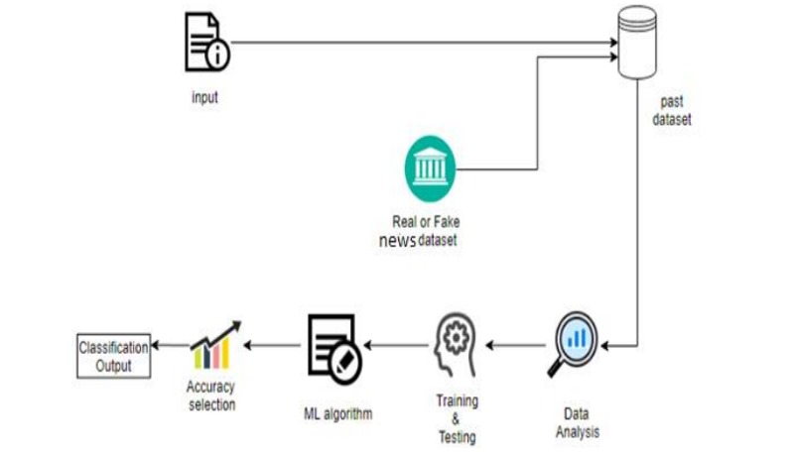
Methodology
Collecting dataset related to Fake News Analysis.
Loading and Analysing dataset.
Building of a new dataset from the set of two datasets.
Preprocessing of the dataset.
Visualization of the data according to the need and also used wordcloud for effective visualization.
Splitting the dataset into training and testing sets.
Choose a Learning Model or Schema for training the dataset.
Fitting the Model with proper parameters and Predicting a feasible outcome(likelihood).
Determining the Model Accuracy Score.
Testing the Model and creating a classification report of them.
Testing the Model with a random news feed from the dataset to verify it’s performance and how well it can guess correctly.

Slide 8
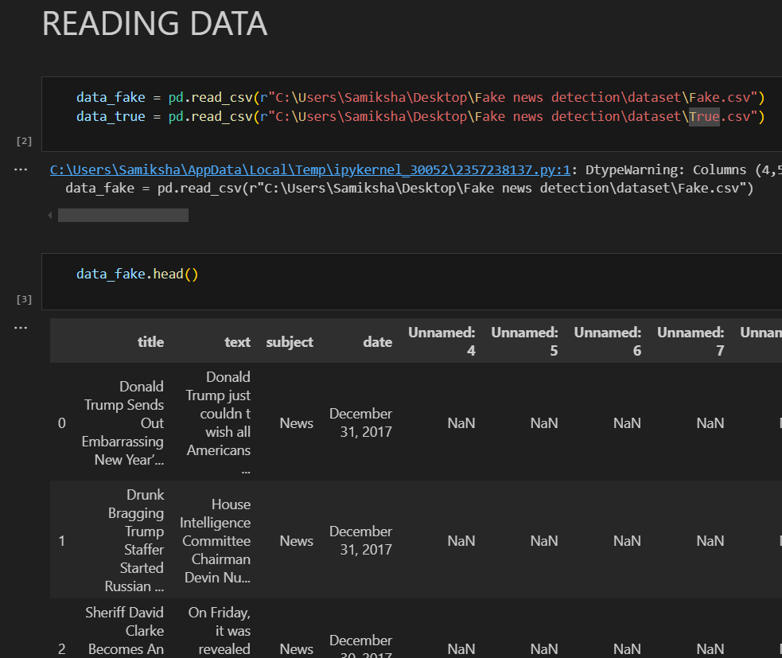
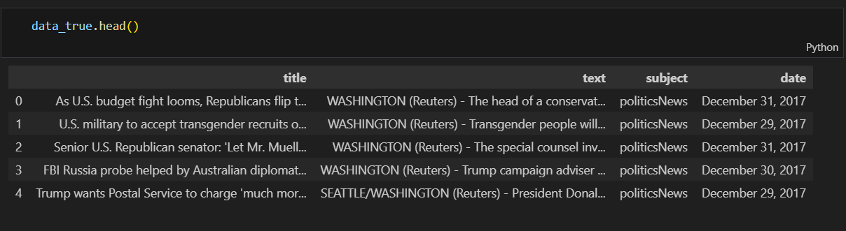
Data Collection
In our quest for accurate fake news detection, we employed a comprehensive approach by integrating multiple datasets. By combining these datasets, we can create a robust and diverse collection of news articles, ensuring a more thorough analysis.
The dataset contains the following attributes :-
Title: the title of a news article
subject: type of the news article
text: the text of the article; could be incomplete
date: date of the news
The conclusion that the information might not be trustworthy.
Fake : Untrustworthy or False News
true : Reliable or Accurate News

Slide 9
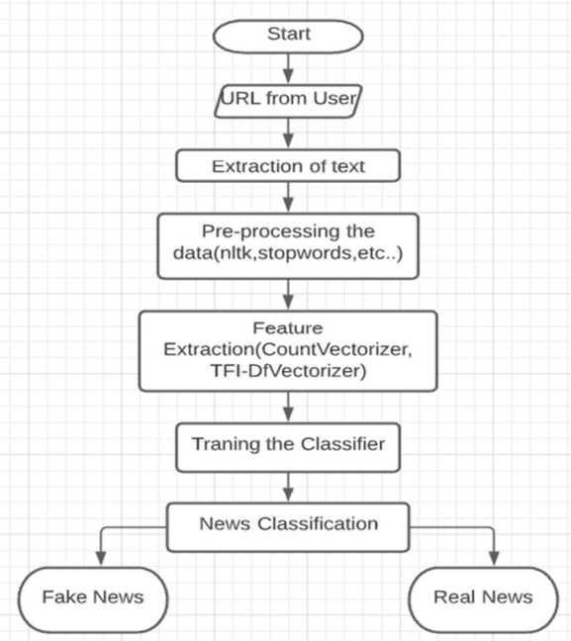
Flowchart

Slide 10
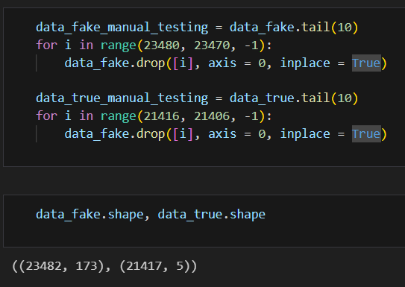
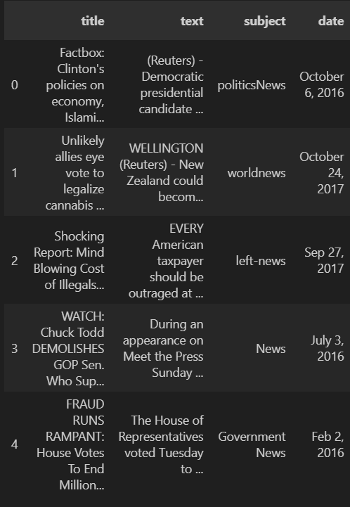
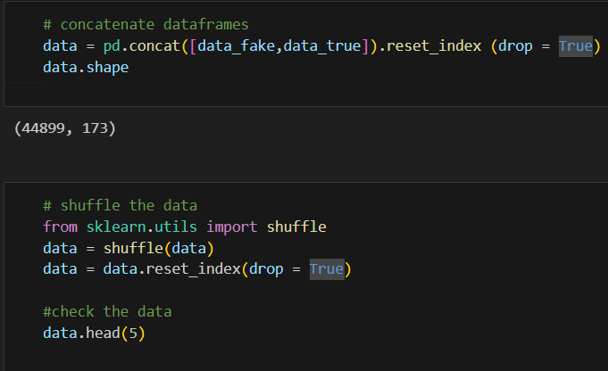
Data Pre - Processing
The dataset has undergone some processing, and those are –
Removed 10 rows from both the true.csv and fake.csv file for the manual testing and then merged both the datasets to get them shuffled for further.
I have cleaned the text by eliminating punctuation and stop words or changed the text accordingly for the evaluation.
Dropped unnecessary columns such as date and title.

Slide 11
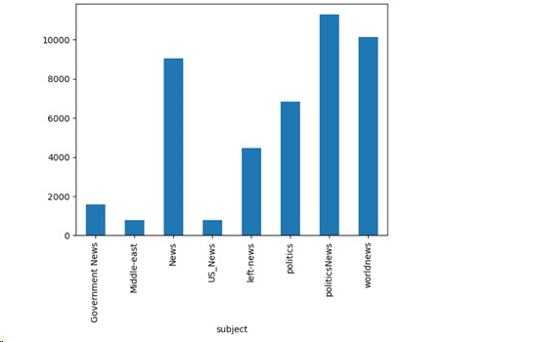
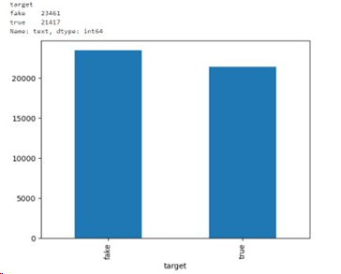
Data Visualization
I have done basic visualization task for the data-
Frequency of subject of the news
Comparison of Fake and Real news

Slide 12
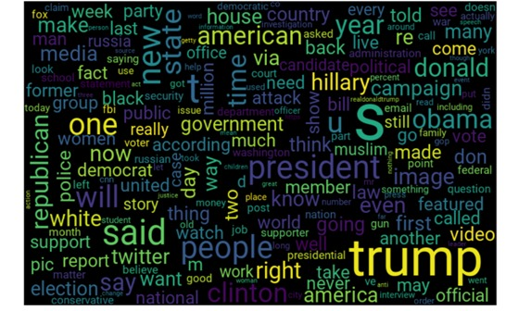
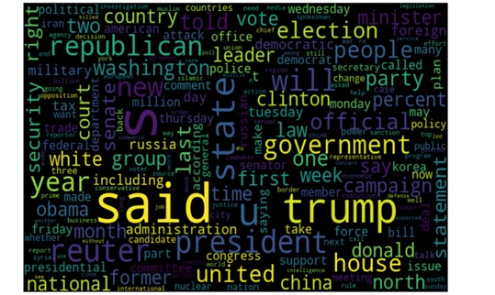
Word Cloud Representation
Representation for the fake news dataset
Representation for the true news dataset

Slide 13
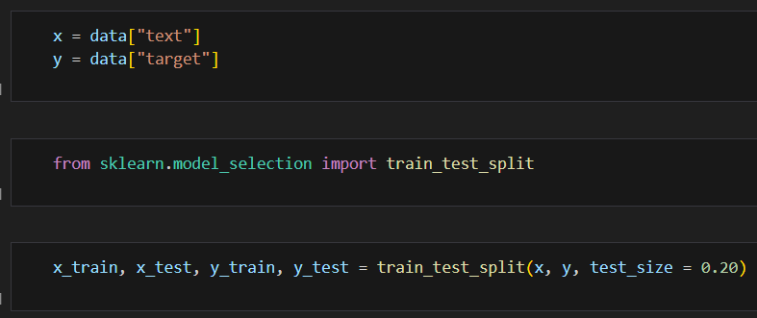
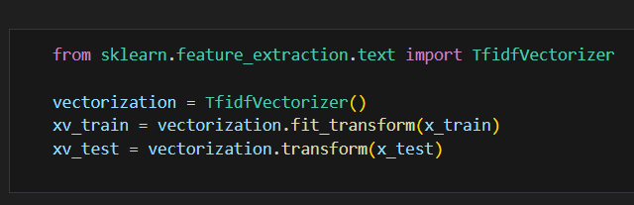
Model Building
Here, I selected my target variables as “text & target” for training & testing dataset for the model fitting and used the Tf-idf Vectorizer in the Sklearn package to turn the text data into numerical data.

Slide 14
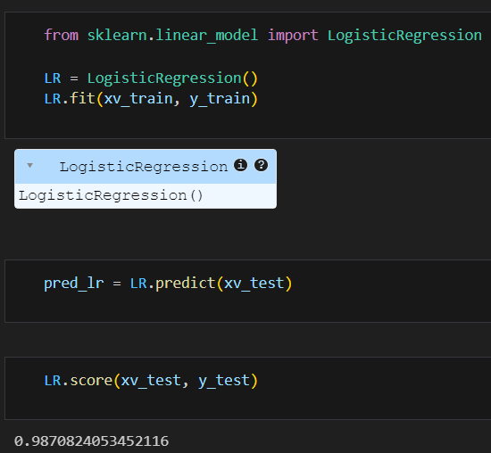
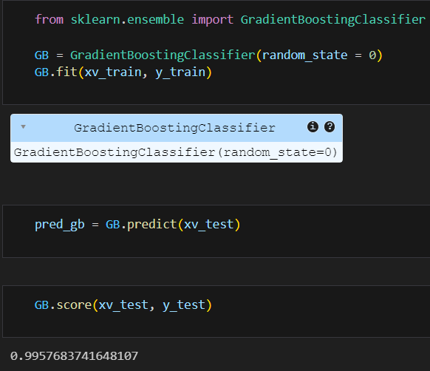
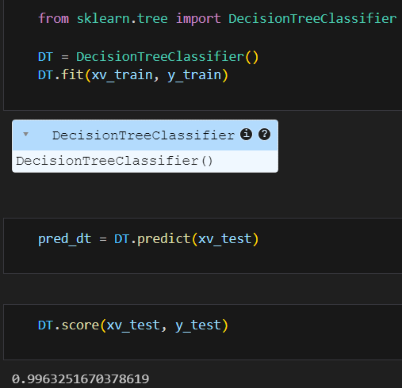
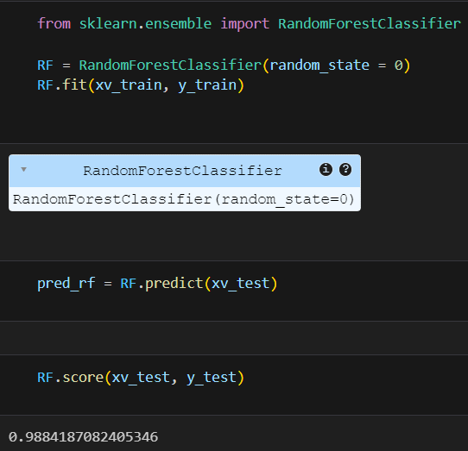
Model Fitting
Now, utilise the data that has been modified by Tf-idf Vectorizer to train a variety of models, including Logistic Regression, Decision Tree, Gradient Bosting, Random Forest, etc. We have Fitted the models using the training set and used the testing set to predict the news article labels, then determined each model's accuracy score using the actual and projected.

Slide 15
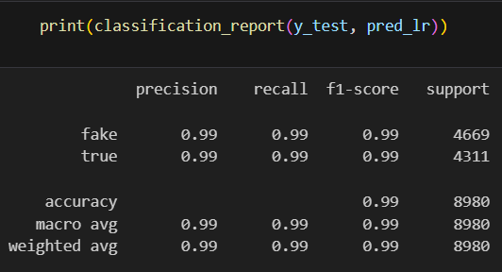
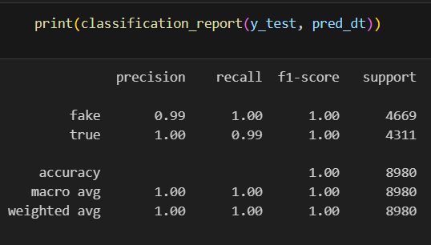
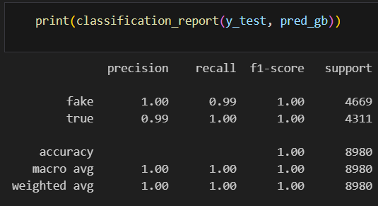
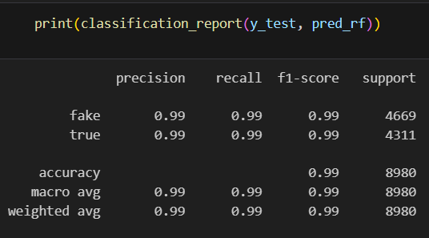
Model Analysis
It is important to check the performance of multiple different machine learning algorithms consistently. The key to a fair comparison of machine learning algorithms is ensuring that each algorithm is evaluated in the same way on the same data. It's crucial to assess the false news detection model's performance on the testing set after we've trained it. By assessing its:
Accuracy
precision,
recall
F1 score
we may do this.

Slide 16
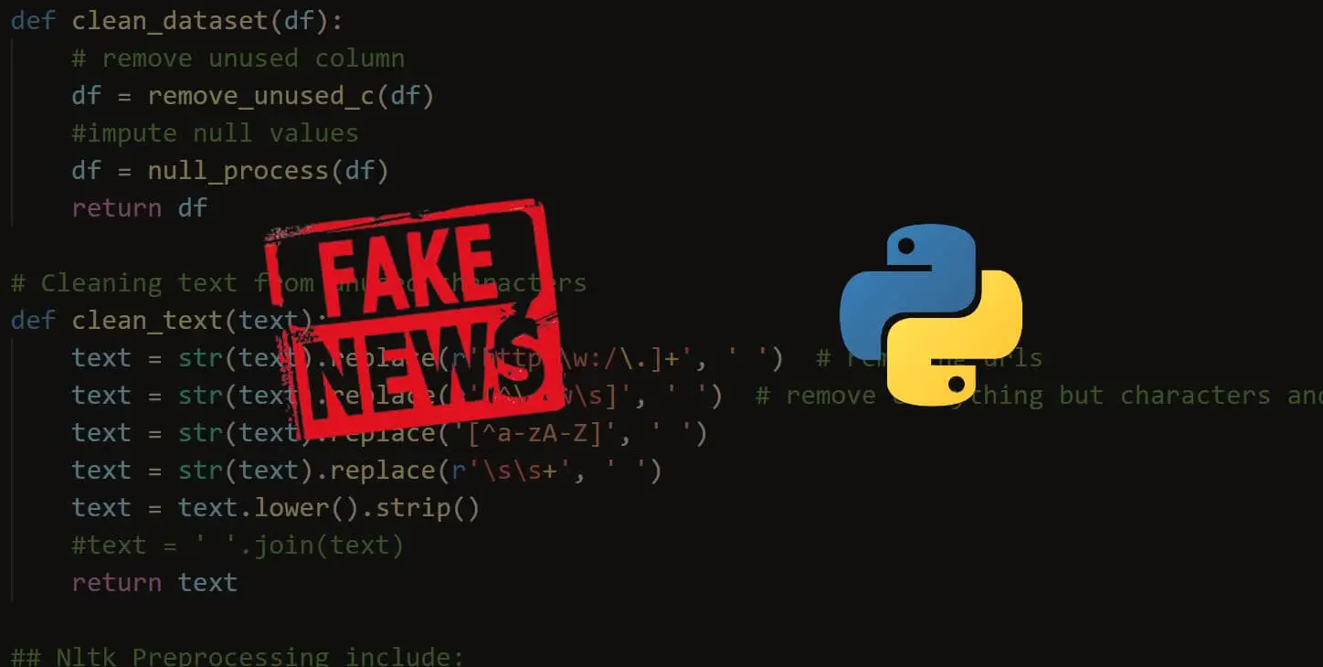
Tools / Platform
PROGRAMMING LANGUAGE: PYTHON
PLATFROM USED: WINDOWS
MACHINE LEARNING ALGORITHM USED:
LOGISTIC REGRESSION
DECISION TREE
GRADIENT BOOSTING
RANDOM FOREST

Slide 17
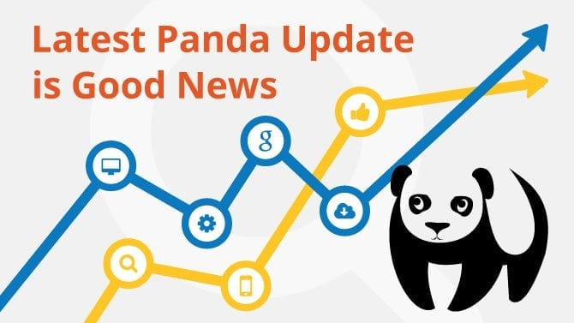
Software Requirements
Windows/Linux/Mac OS any version, hence it can run on any platform.
Python3, it needs python to be installed in system to run successfully.
Packages in python -
NumPy;
Pandas;
Seaborn;
sklearn
Nltk;
Wordcloud;
Streamlit; etc.

Slide 18

Hardware Requirements
In terms of hardware requirements there is not much required at all but still below requirements are must:
1. Working PC or Laptop
2. Proper Internet Connection
PLATFORMS ALREADY TESTED ON:
It is tested on Windows.

Slide 19
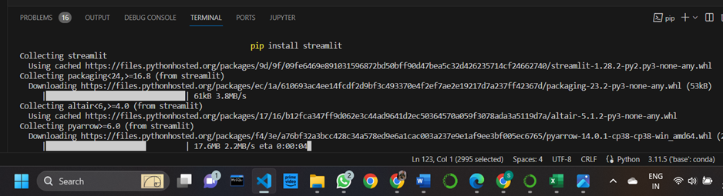

Representing the output in web browser
To create a web interface for the task of fake news detection. We have used streamlit library in Python to build an application for the machine learning model to detect fake news in real-time. Firstly, we installed it on your system using the pip command:
pip install streamlit
We cannot run this code the same way you run your other Python programs. As we are using the streamlit library here, so we need to write a command mentioned below in our command prompt or terminal to run this code:
streamlit run filename.py
Once this command executes, it will open a link on your default web browser that will display your output as a web interface for fake news detection.
Now we can give input as a news article and this application will show you if the news article you gave as input is fake or real.

Slide 20
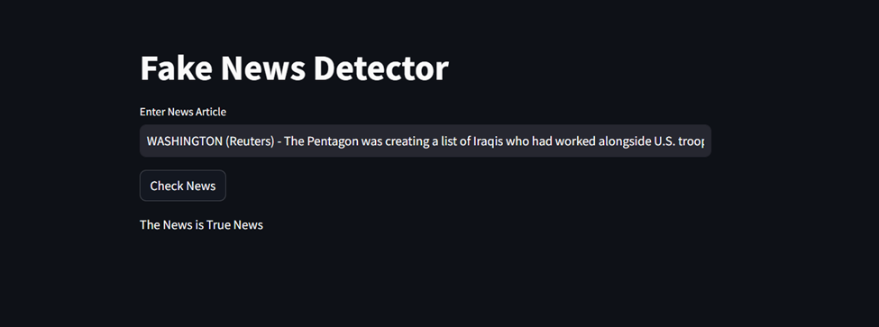
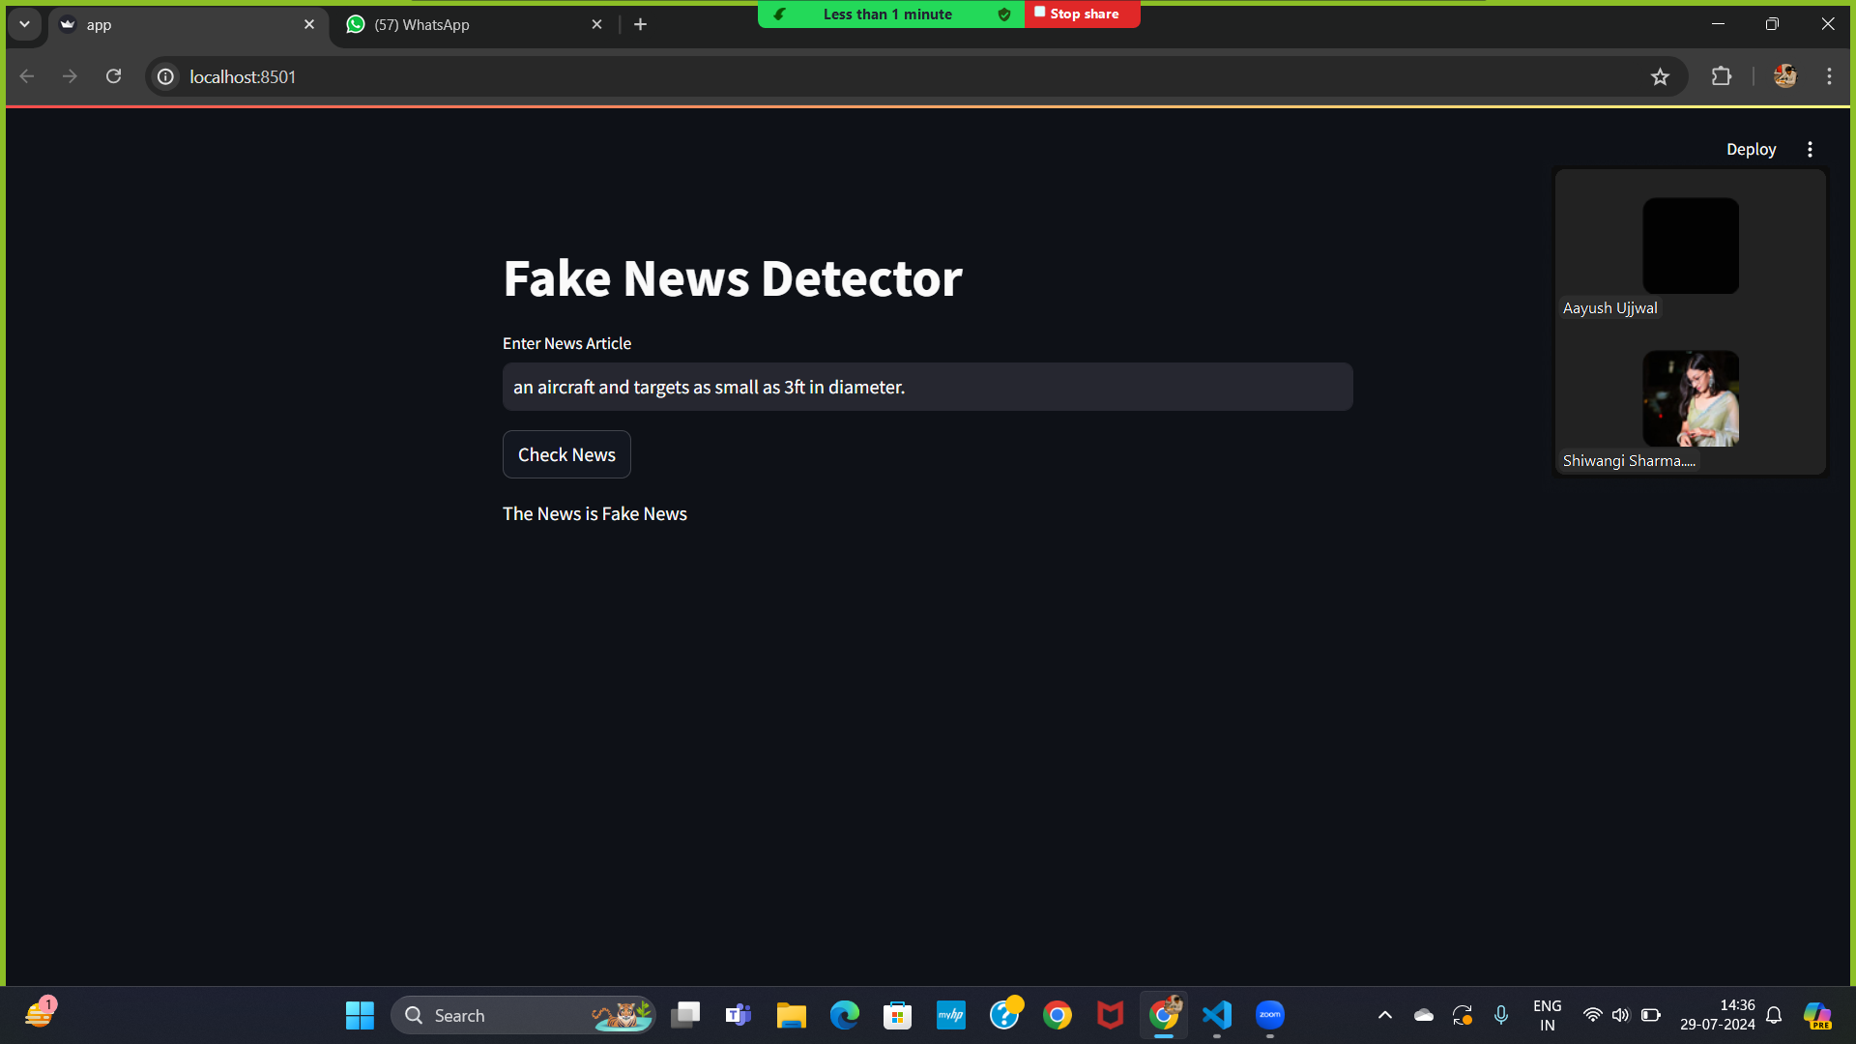
Result And Discussion
This project can understand every sentence of the news articles from the dataset using NLP, then classify the news into real and fake news, so we can search for the news sentences in your own English. It can understand the content and give the result if it is fake or real. We have to update the dataset regularly to get the real-time experience. If we collaborate this model with any of the leading authorised news websites, we can eradicate fake news completely.
The website that got created will take input from the user and present the output as “The News is Fake News Or The News Is True News” according to the selected algorithms.

Slide 21
CONCLUSION
This project comes up with the applications of NLP (Natural Language Processing) techniques for detecting the 'fake news', that is misleading news stories that comes from the non-reputable sources. The result confirms that the prediction of whether news is real, or fake is correct. The main scope of the project is to decrease the fake news which is spread among the people. The accuracy of this project depends upon the dataset we are using. The algorithm we are using, To make it more accurate. Considering the accuracy scores, we were able to establish for the various models, it appears that all of the models are doing a good job of identifying false news items. The Logistic Regression, Decision Tree, Gradient Boosting classifiers and Random Forest. All things considered, the results of the algorithm suggest that a range of classifiers may be used with equal success rates and that machine learning techniques may be extremely successful in spotting bogus news. It's important to keep in mind that accuracy is only one measure and that the models should be evaluated using multiple metrics including precision, recall, and F1-score in addition to factors like interpretability, scalability, and processing requirements. Investigating different feature extraction and selection methods, classifier types, and ensemble approaches may also be useful to see whether even better results may be produced. We utilised the datasets real and fake, each of which had 21417 and 23481 entries, respectively. We converted text into a numerical model using TF-ID F Vectorizer and utilised the following models: Accuracy of 98% for Logistic Regression, 99% for Decision Tree, 99% for Gradient Boosting and accuracy of 99% for the Random Forest Classifier.

Slide 22
FUTURE WORK
The project is working well. The future work can include enhancing the model by using a better fitting algorithms or approaches as that we used cannot be very accurate at all times.
Future efforts to identify bogus news may go in the following directions:
Including more varied and subtle aspects
Creating more interpretable models
Combining information from other sources
Adapting to shifting strategies
The project is scaled for a very limited user base, so it can only detect. It can be scaled up for a greater number of users and thus can be used in other domains. Better technology for night vision can be implemented as it is not appropriate for darker regions.

Slide 23
REFERENCES
For making this project I have used many websites and research papers. The links are below specified:
https://realpython.com/nltk-nlp-python/
https://www.datacamp.com/tutorial/wordcloud-python
https://www.simplilearn.com/tutorials/machine-learning-tutorial/how-to-create-a-fake-news-detection-system
https://www.datacamp.com/tutorial/streamlit
I have also used so many other YouTube channels and google to solve our errors.
I used Official python documentations to code in python.

Slide 24

THANK YOU

